Slide 1

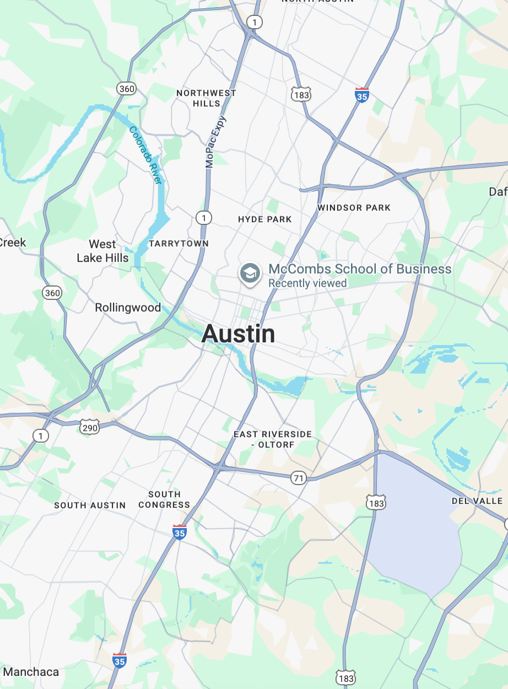
Introduction
Methodology
Results
Questions
Dwelling.
Your new apartment finding best friend.
Explore Now
Joseph Bailey, Jack Feen, Peyton Gibbs, Humphrey Hui, Archie Korale, Sam LeFebre

Slide 2

Introduction
Methodology
Results
Questions
The Problem.
WHAT RENTERS CARE ABOUT
- NEIGHBORHOOD SAFETY
- PLACES TO EAT
- SCHOOLS NEARBY
- ACTIVITIES TO DO
- ETC.
...Dwelling bridges this gap by pulling data from hundreds of nearby locations to give better apartment recommendations.
WHAT RENTAL WEBSITES PROVIDE
- APARTMENT FEATURES
- PRICE
- LOCATION
Dwelling.

Slide 3





Introduction
Methodology
Results
Questions
DATA SOURCES
Neighborhood Group
SELENIUM
Image
Apartment Information
Neighborhood Group
API CONNECTION
Reddit Posts and Comments
API CONNECTION
Nearby Locations
Dwelling.
Notes:
Heres what we used the data sources for.
categories = [
'grocery_or_supermarket',
'pharmacy',
'hospital',
'doctor',
'dentist',
'veterinary_care',
'restaurant',
'cafe',
'bar',
'gym',
'park',
'spa',
'shopping_mall',
'convenience_store',
'transit_station',
'bus_station',
'subway_station',
'gas_station',
'movie_theater',
'museum',
'library',
'night_club',
'school',
'university',
'bank',
'atm',
'post_office',
'laundry',
'police',
'fire_station'
]

Slide 4






Introduction
Methodology
Results
Questions
DATA SPECIFICS
Apartment Information
Name of Residence
Number of Beds and Baths
Address and Zip Code
Rent
Image
Processed 150 apartment images using Google Cloud Vision API in 78 seconds
Generated binary amenity features (pool, balcony, modern kitchen) from visual labels
Calculated luxury scores based on premium materials and design quality
Processed apartment images using Google Cloud Vision API
Generated binary amenity features (pool, modern kitchen) from visual labels
Calculated luxury scores based on premium materials and design quality
Neighborhood Group
Created 14 neighborhood groups and divided each apartment complex based on area code
Used VADER to create a sentiment score for each Reddit post [-1, 1]
Assigned Reddit posts to a neighborhood using roBERTa and keyword matching
Reddit Posts and Comments
Created 14 neighborhood groups and divided each apartment complex based on zip code
Used VADER to create a sentiment score for each Reddit post [-1, 1]
Assigned Reddit posts to a neighborhood using roBERTa and keyword matching
Neighborhood Group
Dwelling.
Notes:
The processing we did on these data sources

Slide 5
Introduction
Methodology
Results
Questions
DATA
GOOGLE VISION
+
FEATURE SCORING
Apartment Feature Score
(10%)
Image
Apartment Information
Overall Apartment Score
Neighborhood Score
(30%)
Neighborhood Group
SENTIMENT ANALYSIS
Reddit Posts and Comments
COSINE SIMILARITY
+
DISTANCE SCORING
Local Features Score (60%)
Distance to ‘Target’ Location
(max distance – actual distance)
x
100
Nearby Locations
max distance
Dwelling.
User’s desired features (text) factored in
User’s desired location factored in
Notes:
final_score = (sentiment × 0.4) + (distance × 0.3) + (amenities × 0.3)
```
The weights are customizable, but default to 40% sentiment, 30% distance, 30% amenities.
---
## **Component 1: Sentiment Score (0-100)**
**Source:** Average Reddit sentiment for the apartment's neighborhood
**How it works:**
1. Reddit posts are grouped by neighborhood
2. Average sentiment is calculated per neighborhood
3. This average is joined to apartments based on their `neighborhood_group`
4. Normalized to 0-100 scale (if originally -1 to 1, etc.)
5. Missing values default to 50 (neutral)
**Example:**
- Hyde Park neighborhood has average sentiment of 0.6 (on -1 to 1 scale)
- Normalized: `((0.6 + 1) / 2) * 100 = 80`
- All Hyde Park apartments get sentiment_score = 80
---
## **Component 2: Distance Score (0-100)**
**Formula:** `(max_distance - actual_distance) / max_distance × 100`
**How it works:**
- Closer apartments score higher
- Linear decay from your chosen location
- Max distance is 5 miles (apartments beyond this are filtered out)
**Example:**
- You're at location X
- Apartment A is 1 mile away: `(5 - 1) / 5 × 100 = 80`
- Apartment B is 4 miles away: `(5 - 4) / 5 × 100 = 20`
---
## **Component 3: Amenity Score (0-100)**
This is the most complex part! It's calculated **per amenity** the user cares about, then averaged.
### **Step 3a: Match User Input to Categories**
**User says:** "elementary schools"
**System does:**
1. Encodes "elementary schools" into a 384-dimensional vector
2. Encodes all Google categories into vectors
3. Calculates cosine similarity between them
4. Filters matches by confidence:
- < 0.5: ignored
- 0.5-0.7: regular match (1.0x bonus)
- 0.7-0.85: high confidence (1.2x bonus)
- \> 0.85: super confidence (1.5x bonus)
**Example matches:**
- `school` category: 0.82 similarity → 1.2x bonus
- `university` category: 0.45 similarity → ignored (too low)
---
### **Step 3b: Score Places for This Amenity**
For each place in the Google Places data:
**1. Check if place matches the category**
- Does this place have type `school`? If yes, it's a candidate
**2. Calculate name similarity**
- User input: "elementary schools"
- Place name: "Highland Park Elementary"
- Encode both, calculate similarity: 0.75
**3. Calculate combined confidence**
```
combined_confidence = (category_confidence × 0.7) + (name_similarity × 0.3)
```
**Example:**
- Category confidence: 0.82
- Name similarity: 0.75
- Combined: `(0.82 × 0.7) + (0.75 × 0.3) = 0.574 + 0.225 = 0.799`
**4. Apply bonus multipliers**
- If both name AND category > 0.7: 1.5x bonus (both match really well!)
- If name > 0.5: 1.2x bonus (name matches decently)
- Otherwise: use original category bonus
**In this example:**
- Name (0.75) > 0.7 ✓
- Category (0.82) > 0.7 ✓
- Final bonus = 1.2 × 1.5 = 1.8x
**5. Calculate distance from apartment**
- Uses haversine formula to get miles
- Only includes places within 5 miles
**6. Calculate weighted score for this place**
```
distance_score = (5 - distance) / 5 × 100
weighted_score = distance_score × bonus × combined_confidence
```
**Example:**
- Place is 0.5 miles from apartment
- Distance score: `(5 - 0.5) / 5 × 100 = 90`
- Weighted score: `90 × 1.8 × 0.799 = 129.5` (capped at 100)
---
### **Step 3c: Take Top 3 Matches**
1. Calculate weighted_score for ALL matching places
2. Sort by weighted_score (highest first)
3. Take top 3
4. Average their scores → **amenity score for "elementary schools"**
---
### **Step 3d: Repeat for All Amenities**
**User cares about:** `['elementary schools', 'parks', 'grocery stores']`
**Process:**
1. "elementary schools" → score = 85
2. "parks" → score = 70
3. "grocery stores" → score = 95
**Average amenity score:** `(85 + 70 + 95) / 3 = 83.3`
---
## **Final Calculation**
**Apartment at 123 Main St:**
- Sentiment: 80 (Hyde Park neighborhood)
- Distance: 75 (2 miles away)
- Amenities: 83.3 (average of all amenity scores)
**Final score:**
```
(80 × 0.4) + (75 × 0.3) + (83.3 × 0.3)
= 32 + 22.5 + 25
= 79.5

Slide 6

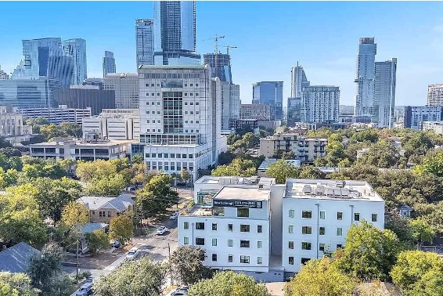
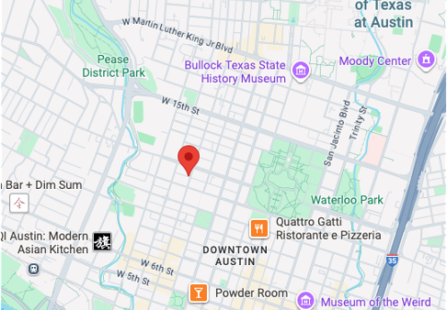

Introduction
Methodology
Results
Questions
TEST 1
1108 Nueces Street
The Capitol Living
For our first test, we placed ourselves in the shoes of a young adult
We imagined them wanting to be near a college, thrift shop, and nightclub in Downtown Austin
HIGHLIGHTS
6 minutes to UT
2 minutes to Downtown/6th Street
Dwelling.

Slide 7
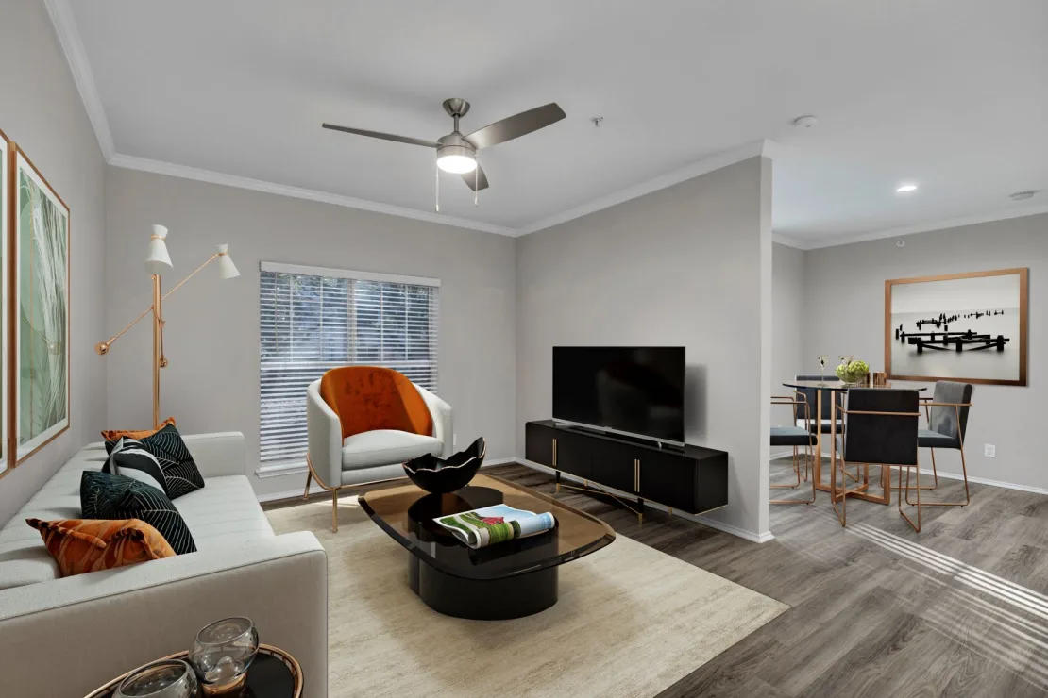
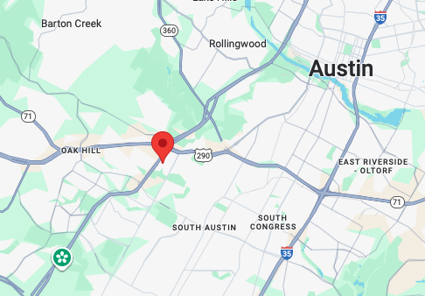
Introduction
Methodology
Results
Questions
TEST 2
5701 South Mopac Expressway
River Stone Ranch
For our second test, we placed ourselves in the shoes of a young family
We imagined them wanting to be near an elementary school, pediatrician, and grocery store also in Downtown Austin
HIGHLIGHTS
Placed in between two elementary schools
5-10 minutes to both a medical center and a Target
Dwelling.

Slide 8
Introduction
Methodology
Results
Questions
Questions?
Dwelling.

